Slide 1
Web Scraping Advanced
Pili Hu

Slide 2
More on search engine

Slide 3
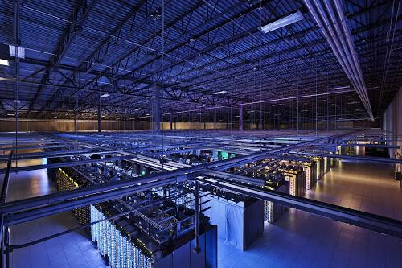
Search Engine
Offline:
Crawl web pages
Massive distributed storage
Build reverse index
Keyword → page
Extract page-level features
PageRank
Site classification
Online:
Query analysis
Search
Rank
Google’s data center

Slide 4
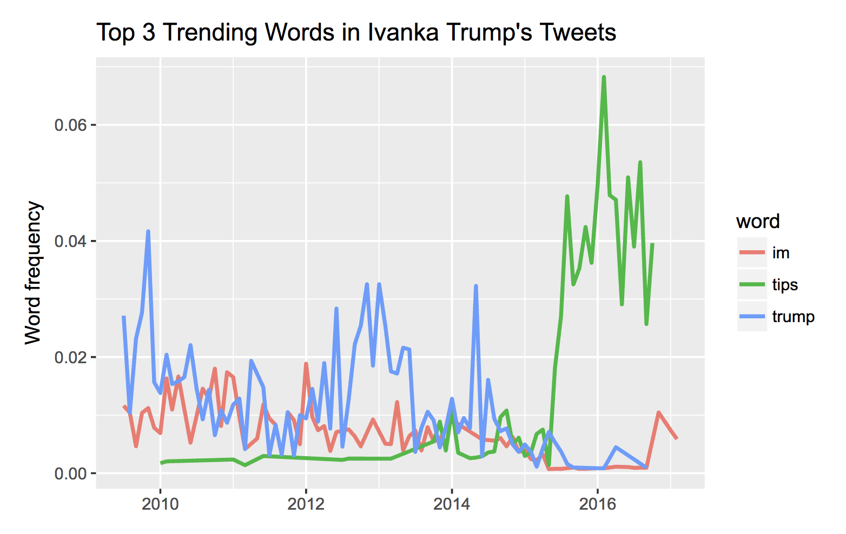
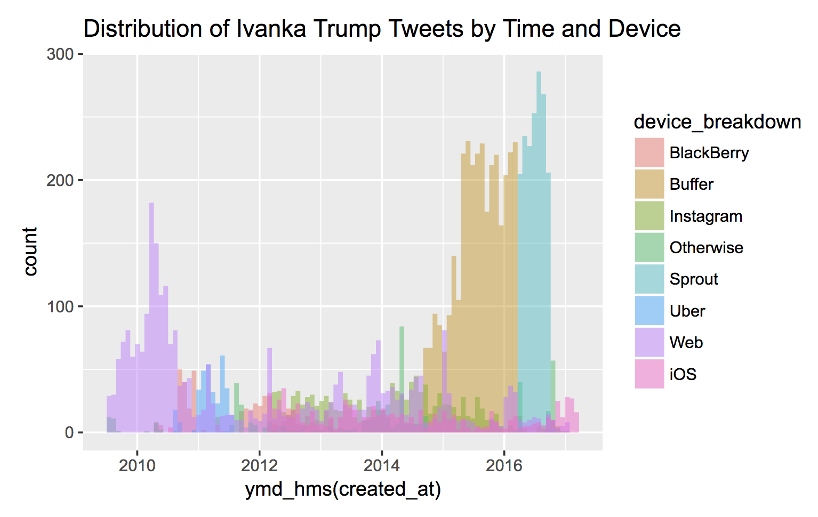
Data Journalism
Ideation
Data collection
Data analysis
Exploratory analysis
Hypothesis testing
Story telling
Data visualisation
Turn story into visuals
As part of/ one way of analysis
Publication
Tweets analysis of Donald Trump and Ivanka Trump
http://initiumlab.com/blog/20170329-trump-and-ivanka/

Slide 5
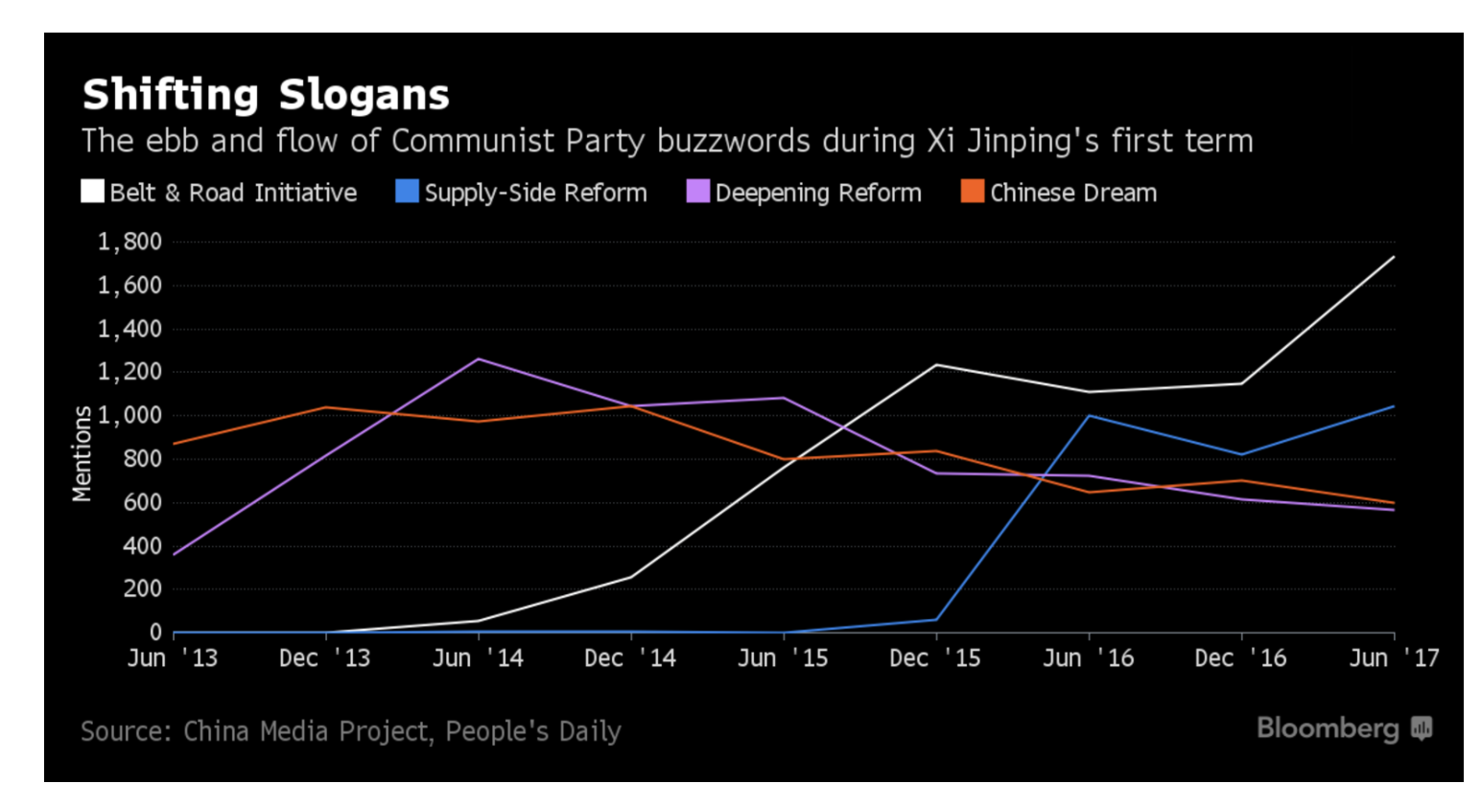
Analysis of public opinion environment
Collect articles from People’s daily
Run text analysis
Visualise keywords in time series
Here's a Window Into How Xi Has Reshaped China
https://www.bloomberg.com/news/articles/2017-07-18/party-of-one-newspaper-mentions-show-xi-s-dominance-of-china

Slide 6
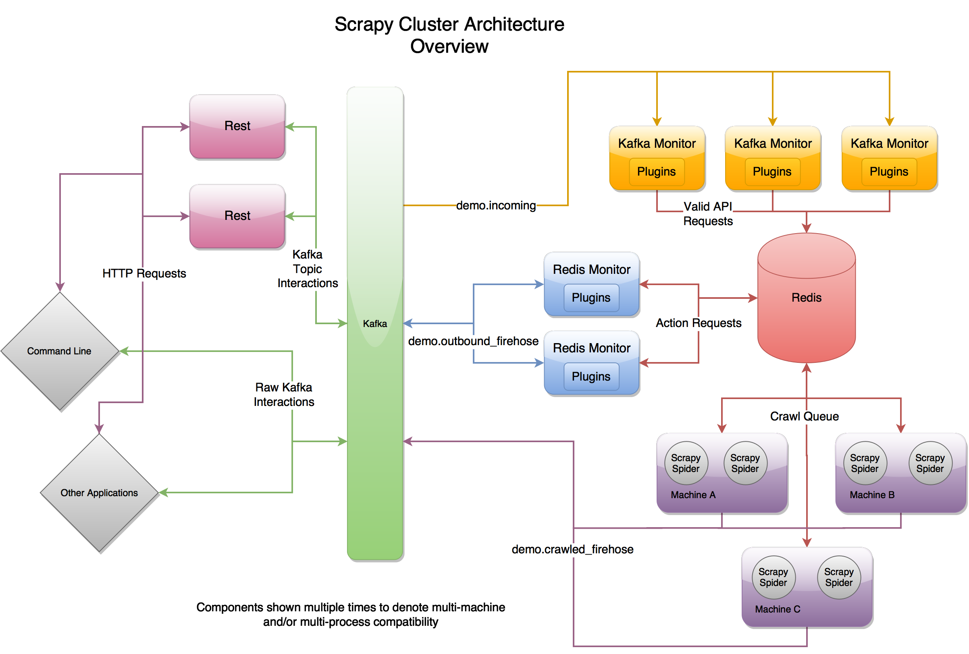
Architecture of a spider
Crawler
Analyse page structure;
Get followup URLs;
Continuously visit followup URLs to retrieve resources
Parser/ Scraper
Analyse page structure;
Get information of interest
Send parsed information to a database (which can be as simple as a text file/ spreadsheet file)
Source: scrapy-cluster

Slide 7
Crawler/ Scraper
Sometimes used interchangeably
Our discussion mainly focuses on “parser” level
Input is an HTML document (semi-structured)
Output is structured dataset
CSV file
List of list (Python data structure)
List of dict (Python data structure)
Relational databases -- MySQL, PostgreSQL, ...

Slide 8
Issues with crawler/ scraper
Ethics:
Can or can not?
Can you take pictures or recordings without the consent of the interviewee?
Robot.txt
Technical:
Rate throttling by IP addresses
Limit user-agent (browser)
Use cookie
Require login (hidden web)
Captcha

Slide 9
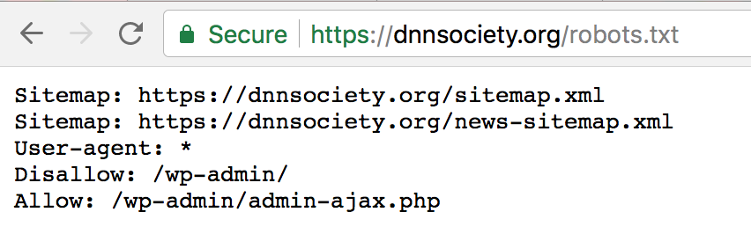
Permissions to crawl
Where:
robot.txt -- a text file specifying who (in terms of “user-agent”) can visit what content.
User license, user agreements, terms and services, ...
Two big protective umbrella:
Fair use principle -- valid in Hong Kong, for teaching/ learning/ research purpose
Public interest -- Media organisations/ individual journalists are entitled

Slide 10
Issues during scraping

Slide 11
Anti Crawling

Slide 12
Browser Emulation

Slide 13
Selenium
Example:
https://github.com/hupili/python-for-data-and-media-communication-gitbook/blob/master/notes-week-06.md#example-cnn-articles-scraping

Slide 14

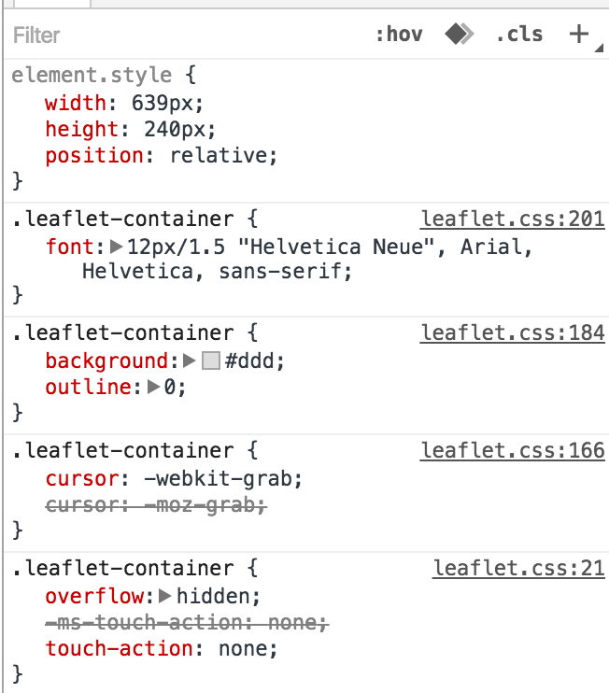
Different element → different key
Different key → different value set
Selector
Key:Value;

Slide 15
Mini Hackathon
Continue with static scraping
Or, try a dynamic scraping

